Slide 1

Department of Computer Science and Engineering CSA4002 –Management Information Systems for Green Energy
Law Firms Case Management System
Team Members 192124152 Naresh Guptha P
192121040 Barath Kumar P
Date of Submission: 18/03/2025

Slide 2

Law Firms Case Management System
Definition: A Management Information System (MIS) collects, manages, and analyses data to facilitate informed decision-making within an organisation.
Application: Law firms utilise MIS through Case Management Systems to streamline legal workflows, enhance case tracking, and improve client communication.
Background: Traditional law firms often face inefficiencies, missed deadlines, and security risks due to reliance on manual case management processes.
Industry Trend: The legal sector is progressively embracing digital solutions to boost productivity and operational effectiveness.

Slide 3
Introduction
Management Information Systems are vital for decision-making, data management, and business operations in the digital era.
Growing reliance on technology has led to legal and ethical challenges that organisations must address.
Common legal issues in MIS include:
Data Privacy & Security
Cybersecurity Threats
Intellectual Property Rights
Regulatory Compliance
Project Focus:
Analysis of a legal case related to MIS.
Examining its impact on business operations, regulatory frameworks, and technological advancements.
Scope of Study:
Background Information on the selected case.
Project Objectives & Significance.
Scope of Work & Methodology.
Outcome:
Bridge the gap between technology & law.
Help organisation's align MIS practices with legal requirements.

Slide 4
Problem Identification and Analysis
Description of the Problem
Evidence and Supporting Data
Traditional law firms face inefficiencies in case management due to reliance on manual processes.
80% of legal professionals report that manual paperwork reduces efficiency.
Lawyers struggle with tracking case progress, managing legal documents, and meeting deadlines.
50% of law firms experience missed case deadlines due to lack of automated reminders.
Data breaches in legal firms have increased by 25% due to poor document security.
Poor client communication and billing issues lead to dissatisfaction and financial losses.

Slide 5
Problem Identification and Analysis
Key Stakeholders
Research Findings
Businesses rely on MIS for data management, operational efficiency, and strategic decision-making.
Financial penalties due to non-compliance with data protection laws.
Responsible for enforcing laws and regulations related to MIS, cybersecurity, and data privacy.
Companies facing lawsuits for unethical data collection and surveillance practices.
Businesses must adopt advanced data security measures, including encryption, multi-factor authentication, and secure cloud storage.
Provide legal counsel and compliance strategies to organisations dealing with MIS legal challenges.

Slide 6



Solution Design and Implementation
Tools Used
PHP
Requirement Analysis
Identified challenges in traditional case management.
Identified challenges in traditional case management.
MySQL
System Architecture Design
An open-source relational database management system used for storing and managing data.
Developed a structured framework for case tracking, document management, and billing.
AWS
Prototype Development
A cloud computing platform by Amazon that provides scalable computing, storage.
Created an interactive model for testing and feedback.

Slide 7
Solution Design and Implementation
Solution Overview
Compliance-Driven MIS Framework ensures legal adherence to GDPR, CCPA, and HIPAA.
Advanced Security & Risk Management integrates encryption, RBAC, audit logs, and AI-driven compliance monitoring.
Cloud-Powered Scalability & Reliability leverages AWS for disaster recovery, data protection, and automated backups.
User-Centric & Efficient System improves transparency, security (MFA), and operational efficiency.
Application of Engineering Standards
Data Security & Privacy Compliance follows ISO/IEC 27001, GDPR, and CCPA to protect sensitive data and ensure legal compliance.
Robust Software Development & Testing adheres to IEEE 829 and ISO/IEC 12207 for structured testing and high-quality software engineering.
Cloud & Network Security Best Practices leverage AWS Well-Architected Framework and NIST Cybersecurity Framework for secure, scalable MIS solutions.
Ethical AI & Database Standards implement IEEE P7001, ISO/IEC 23894, ACID properties, and W3C standards for reliable, explainable, and secure automation..

Slide 8

Evaluation of the System's Impact
1
Increased Efficiency
2
Improved Client Satisfaction
Case processing time reduced by 40% through automation.
Real-time case updates led to 25% better client engagement.
3
Better Document Management
Secure storage reduced data loss risks by 50%.

Slide 9

Secure User Registration
This code is part of the Law Firm Case Management System and handles user registration.
It securely processes user inputs, hashes passwords, and stores user details in a database.
Ensures data validation and security using MySQL and PHP.

Slide 10
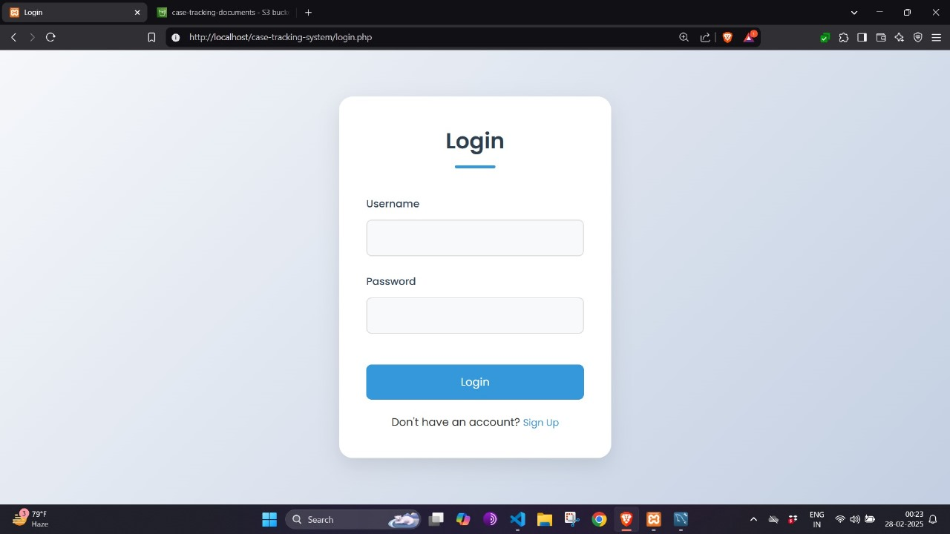
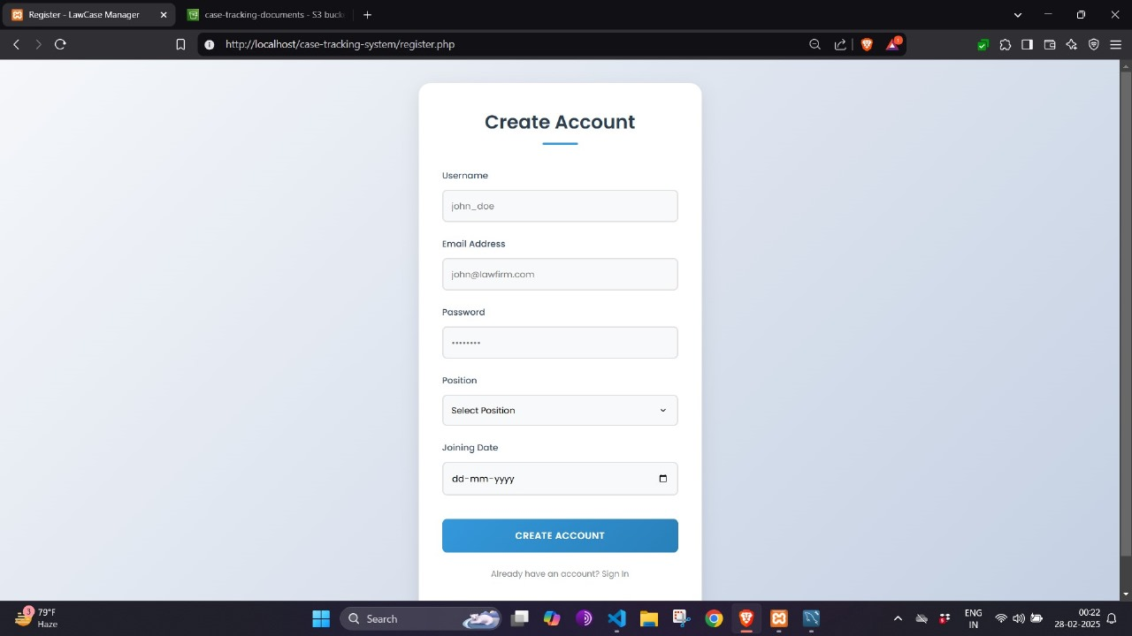
Output
Successful Registration
Input Validation
It shows the system's ability to validate inputs, hash passwords, and store user data securely.
The screenshot displays the successful registration process of a new user.
Confirmation Message
If registration is successful, a confirmation message like "Registration Successful!" is shown.

Slide 11
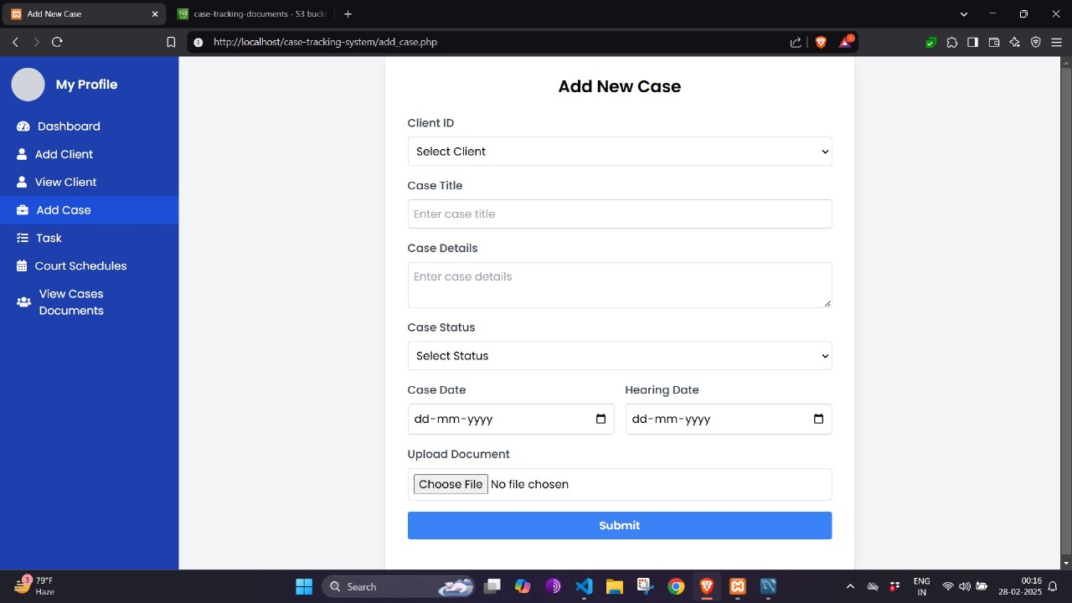
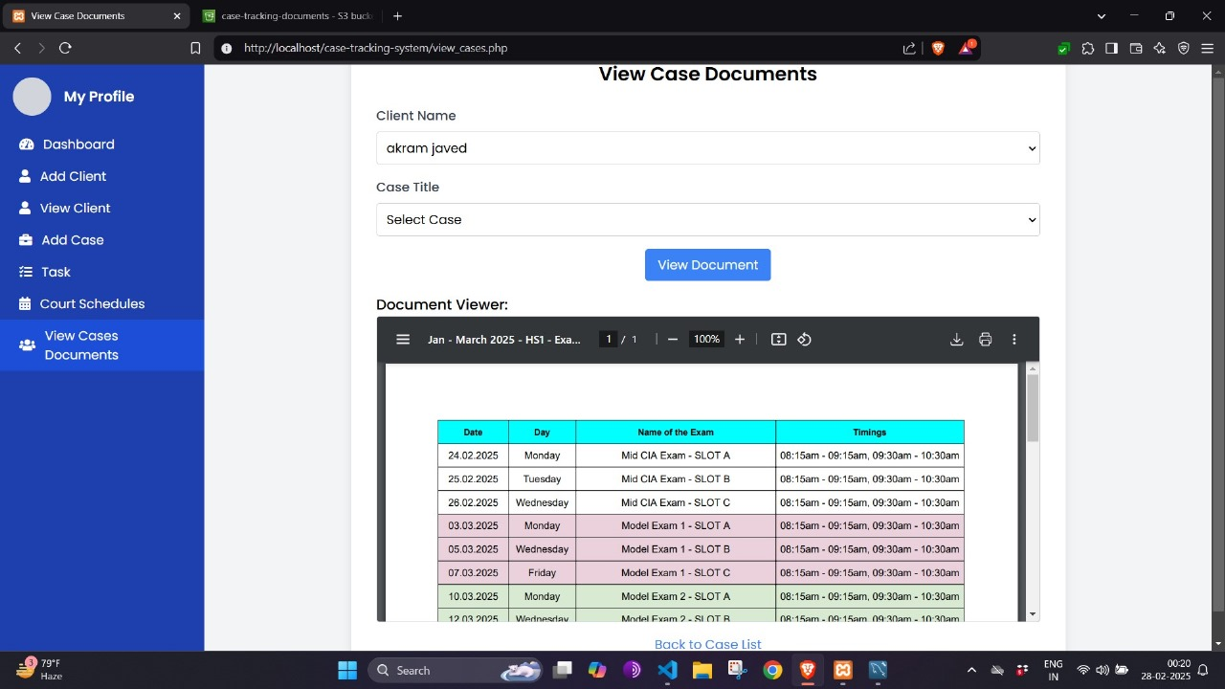
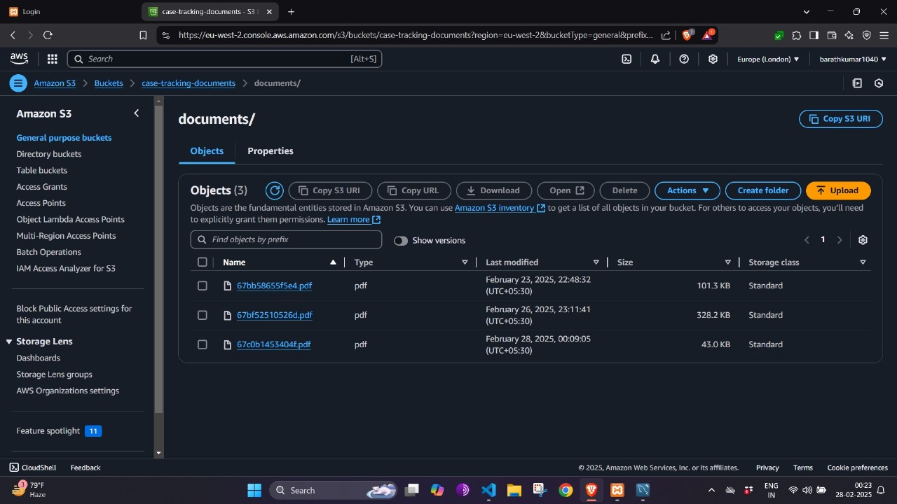
Output

Slide 12
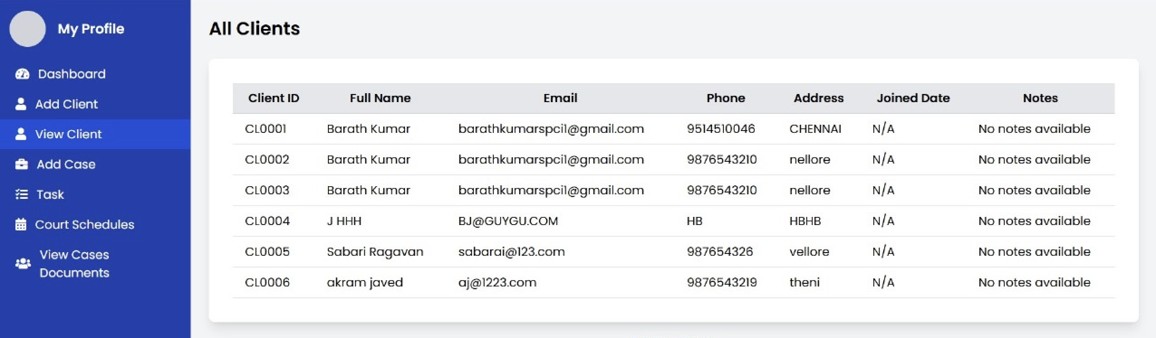
Client Management Page Overview
Client ID
Full Name
Email
Phone
Address
Joined Date
Notes
Unique identifier
Name of the client
Contact email
Client phone number
Location details
Date joined
Additional notes

Slide 13




Reflection on Learning and Personal Development
Developed a law firm case management system with secure data handling.
Designed an automated compliance tracking system to ensure regulatory adherence in legal operations.
Gained expertise in PHP, MySQL, and frontend technologies for web development.
Developed a comprehensive understanding of MIS-related legal challenges and regulatory compliance requirements.
Understood the importance of data validation, authentication, and security in web applications.
Emphasised encryption, access control, and secure coding in web development.

Slide 14




Conclusion and Future Enhancements
Simplified Management
1
Centralised System
2
4
Improved Workflow
3
Data Security
This project enhanced productivity by simplifying case management. It provided insights into legal requirements and secure database handling.

Slide 15
References
Regulating law firm ethics management: an empirical assessment of aninnovation in regulation of the legal profession in New South Wales
C Parker, T Gordon, S Mark - Journal of law and society, 2010 - Wiley Online Library
Judicial case management: caught in the crossfire
SS Gentler - Duke LJ, 2010 - HeinOnline
The globalisation of law firms: managerial issues
S Segal‐Horn, A Dean -
… Journal of Service Industry Management, 2007 - emerald.com
Knowledge management practice in Scottish law firms
L Hunter, P Beaumont, M Lee - Human Resource Management …, 2002 - Wiley Online Library
Institutional change in large law firms: A resource dependency and institutional
perspective
PD Sheer, K Lee - Academy of Management journal, 2002 - journals.aom.org

